Slide 1
The Electron Project
G H A S H

Slide 2
What Is Electron?
Electron is a Open Source software development framework .
It helps to build CROSS-PLATFORM desktop applications .
It uses the power of HTML , CSS and JavaScript to develop the applications .
It uses Node.js to power the overall rendering process and working of the software .
Once you have completed engineering of the software , that software is then ready to work on any desktop platform like Windows , Linux or MacOS .

Slide 3
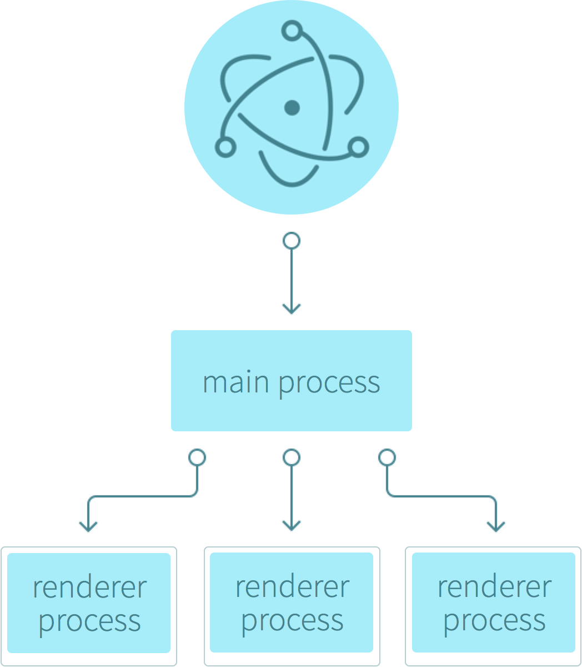
Structure Of An Electron App
The basic structure of an electron app has two parts .
The first part is called the Main Process .
The second process is known as Renderer Process .

Slide 4
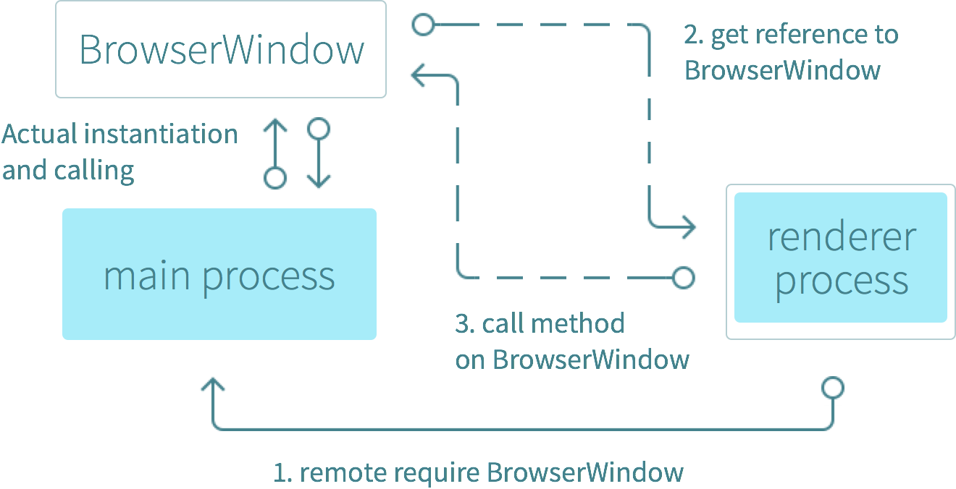
The Main Process
The main process is responsible for creating and managing BrowserWindow instances .
App’s entry point will point to a JavaScript file that will be executed in the main process .
The docs state: “The basic rule is: if a module is GUI or low-level system related, then it should be only available in the main process.”

Slide 5
The Renderer Process
The render process is responsible for running the user-interface of an app, or in other words, a web page which is an instance of webContents .
All DOM APIs, node.js APIs, and a subset of Electron APIs are available in the renderer .

Slide 6
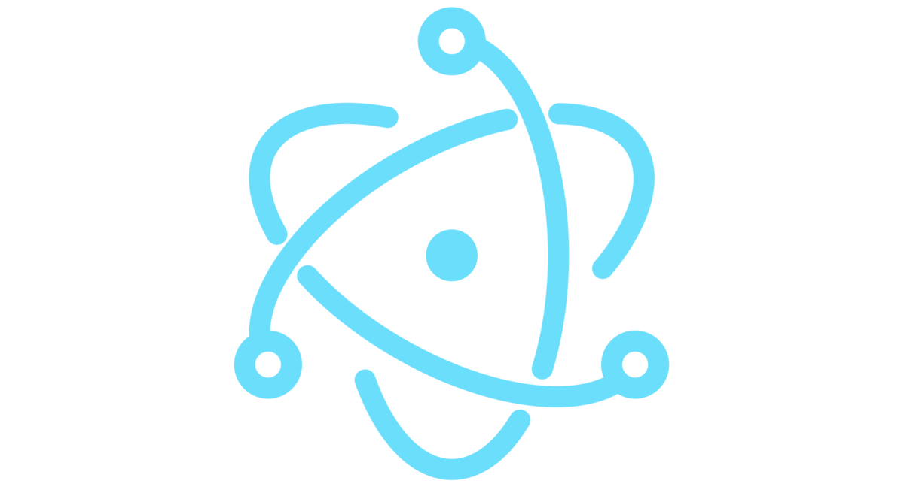
The Venn Diagram
Main Process :
app
autoUpdater
BrowserWindow
contentTracing
dialog
ipcMain
globalShortcut
Menu
MenuItem
powerMonitor
powerSaveBlocker
protocol
session
systemPrefernces
Tray
Renderer Process :
desktopCapturer
ipcRenderer
remote
webFrame
DOM/Browser API’s
Both :
clipboard
crashReporter
nativeImage
shell
screen

Slide 7
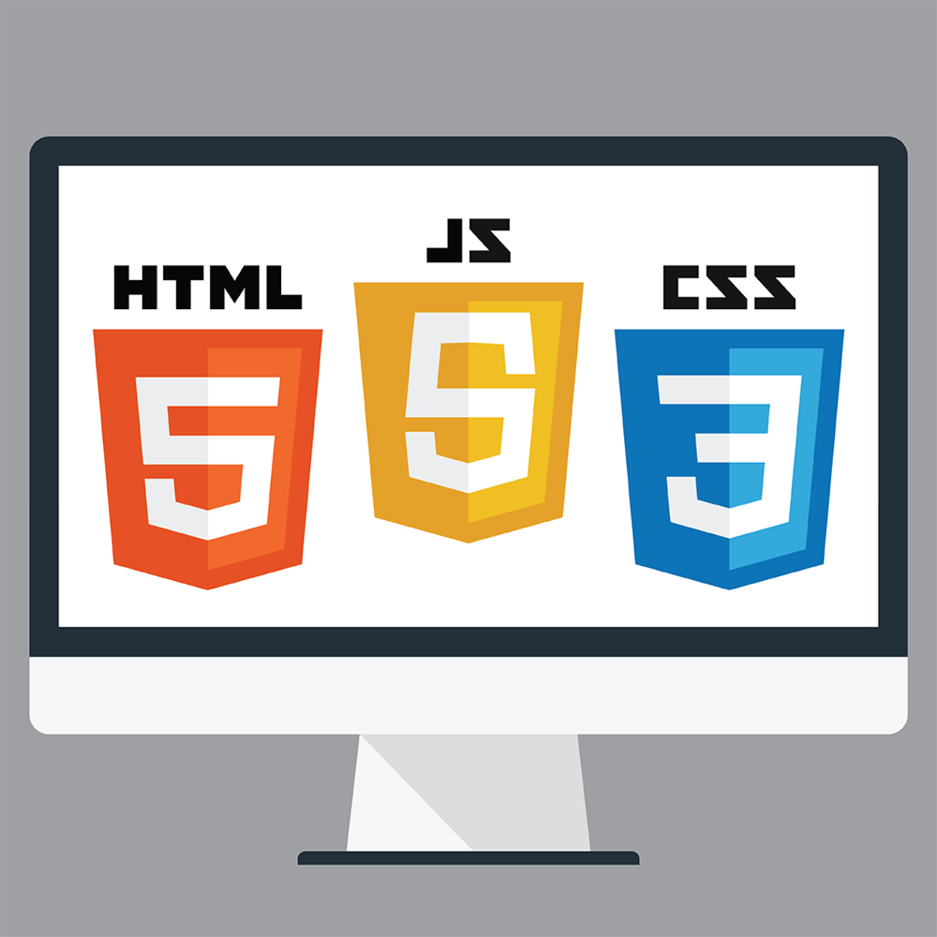
HTML & CSS
All web based applications use HTML & CSS for frontend rendering process .
HTML is used for designing the basic structure of the web application while CSS is used for adding extra styling or we can say beautification of that web application .
In case of electron the objective of these two is the same i.e to provide a good user experience by providing a good and hassle-free frontend .

Slide 8

JavaScript
JavaScript is the most popular scripting language for web applications .
As Electron uses web technologies to create Desktop Applications , it is evident that it also Uses JavaScript .
The JavaScript environment used by electron by default is Node.js .

Slide 9

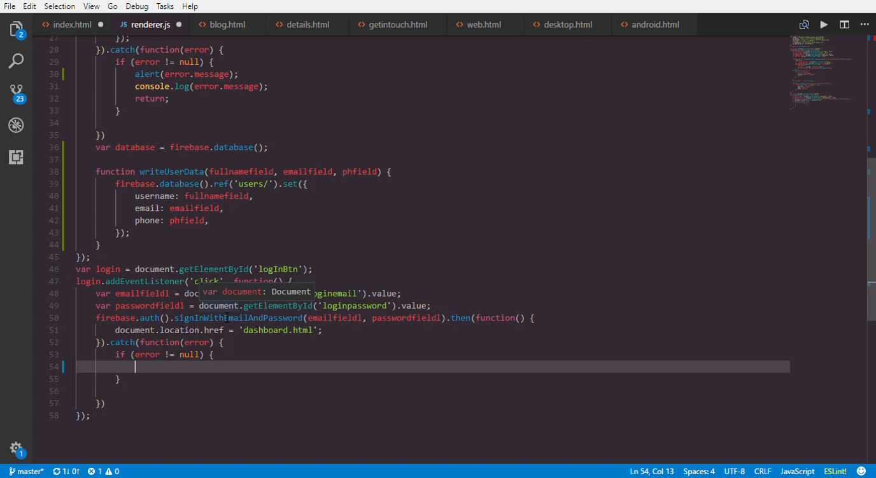
Node.js
Node.js is an open source server framework .
Node.js uses JavaScript on the server .
Node.js enables JavaScript to be used for server-side scripting, and runs scripts server-side to produce dynamic web page content before the page is sent to the user's web browser.
Node.js can be combined with a browser, a database supporting JSON data , JSON for a unified JavaScript development stack. With the adaptation of what were essentially server-side development patterns .

Slide 10

Different JavaScript Frameworks
JS
node
express
particle
vue
Angular
electron

Slide 11

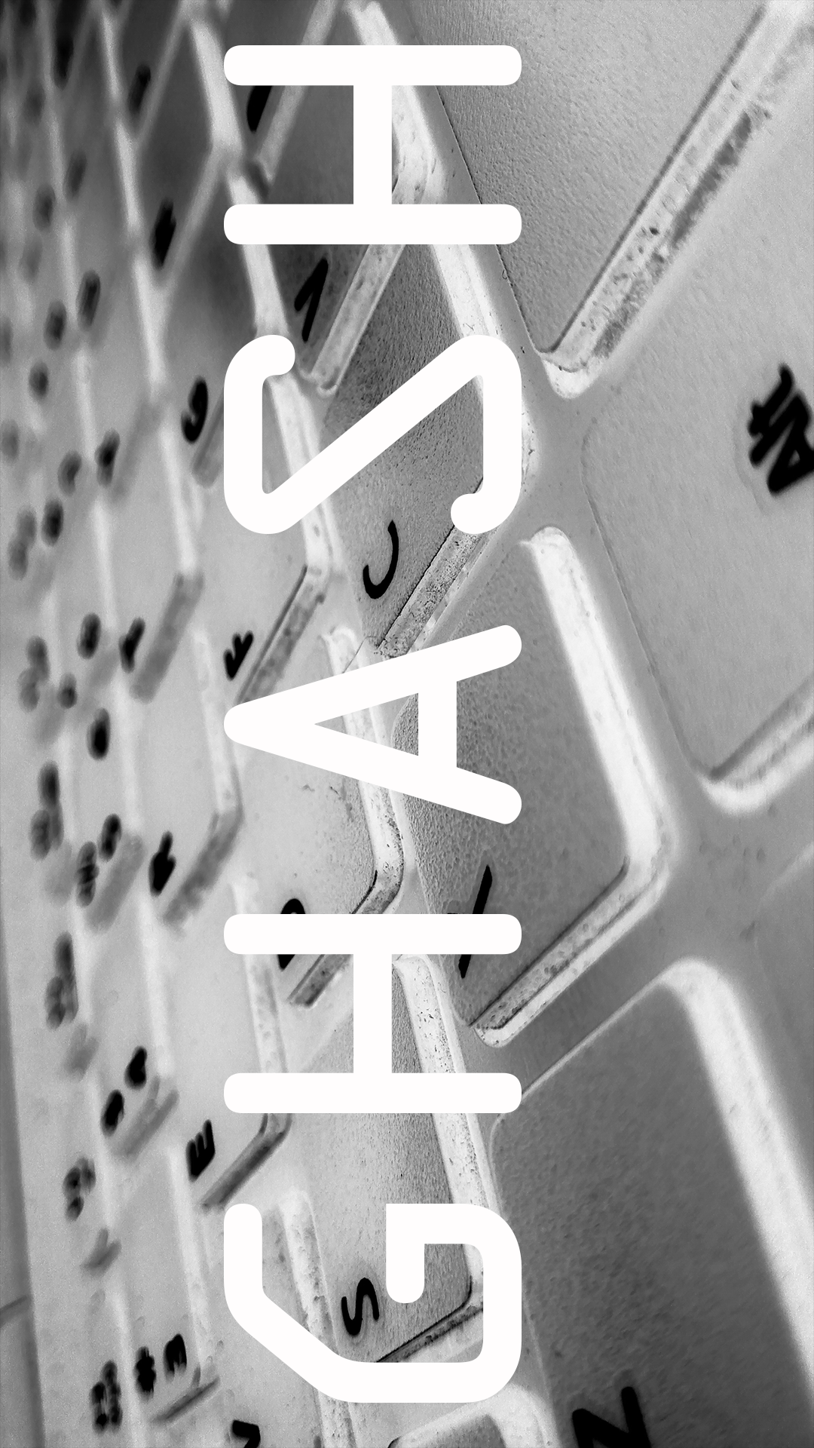
GHASH : The App
GHASH is a desktop application completely built using the Electron Framework .
The main purpose of the GHASH application is to provide rigid and tough passwords which are almost impossible to hack and provide a greater security to the customers .
It also has a feature known as Vault which keeps safe all your password is an encrypted manner .

Slide 12
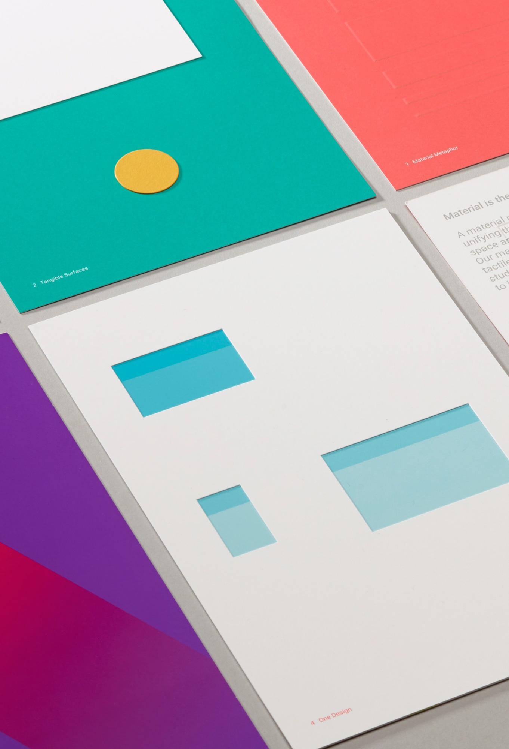
Front-End : HTML , CSS , JavaScript , jQuery
The app’s front end is based on Google’s Material Design Framework .
Material Design is one of the most popular UI design framework which is used in web development as well as most of Android Apps .

Slide 13
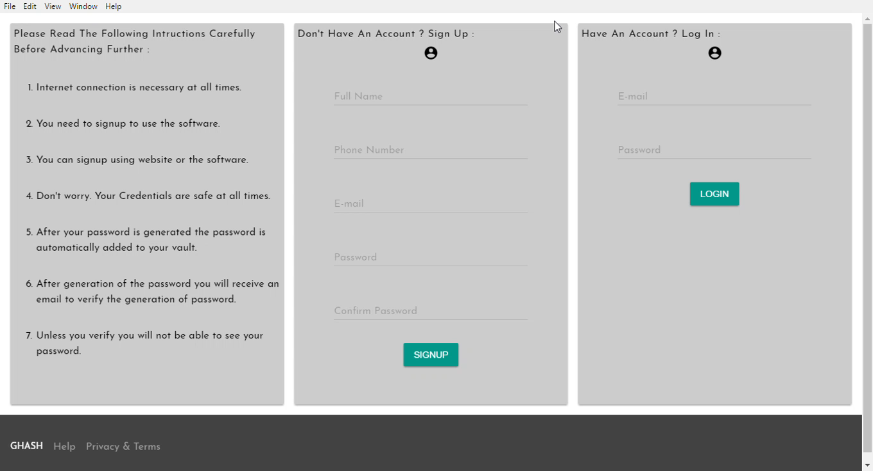

A Sneak-Peek Into The App
The application first need’s to be initiated from console as it has still not been packaged as it is still under Pre-Alpha phase . .
Then we can see the whole application .

Slide 14
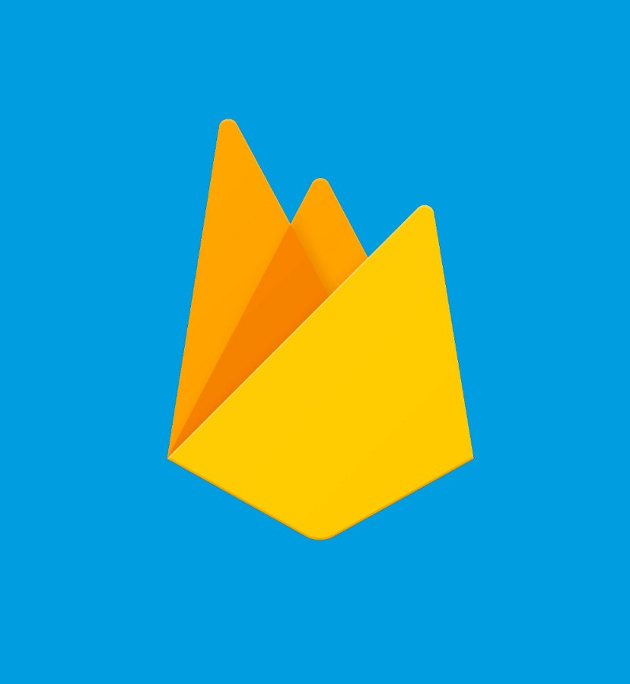
Back-End : Firebase
Firebase is a Baas (Backend As A Service) .
GHASH uses Firebase as its backend to store and retrieve data as well as OAuth authentication and real time data management .
The data is sent to Firebase with the help of JavaScript and then the data is stored in the database and also updated information can be seen in real time on the client machine .

Slide 15
Working Of The Application
Database
Data Fetched
Vault
Data Displayed on Client
Main.js
ipcRemote
Renderer.js
Firebase
Password Authentication
Password Generation

Slide 16
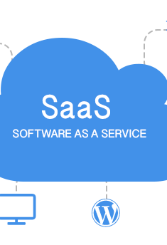
More Of GHASH
GHASH is a Software As A Service (Saas) .
There are 5 types of passwords that it generates .
Each password category has its own set of security guidelines .
The software itself is free but the passwords are not .
The password generated cannot be copied(Ctrl + c) .
There’s a dedicated button which copies the password and you can paste that in the required field .
The passwords are stored after the passwords are encrypted .
When the copy button is clicked a function is triggered which decrypts the password and then it is copied to your clipboard temporarily till it is pasted somewhere else .

Slide 17
Some More Points
GHASH needs Internet Connection for working .
The passwords generated are not added to your GHASH account until and unless you verify yourself through the link sent to you on your email id .

Slide 18
Current GHASH State
Currently at version 0.1.1 .
Based on Material Design Lite .
Uses predefined set of guidelines for generating non-crackable passwords .
Uses Firebase as its backend .
Offline support missing and no mobile support .

Slide 19
Future Of GHASH
Under design process .
Will use Machine Learning to process and generate passwords .
Designed under Materialize CSS , Ajax .
Popular networking sites API are being integrated like Facebook , LinkedIn etc . , so that no need to copy paste passwords . Just click on the Icon you want to and all the authentication will be done by just that one click .
Expected mobile support for Android , IOS and Windows .

Slide 20
Thank You

